Slide 1
Background
This data studies whether or not a driver will accept a coupon recommended to him in different driving scenarios.
The different driving scenarios include the destination of the driver, current time of the drive, the weather, whether the driver has a passenger with them or not, etc., and then the person is asked whether or not they will accept the coupon.

Slide 2
The stakeholder and their problem
The model tries to solve different problems the stakeholders. E.g.
Business owners, it helps them to optimize their marketing strategies and increase sales.
Drivers, it provides personalized recommendations that can help them save money.
Data analysts, it provides a tool for understanding customer behaviour and making data-driven decisions.
Regulators, it helps to ensure fair and ethical marketing practices.

Slide 3
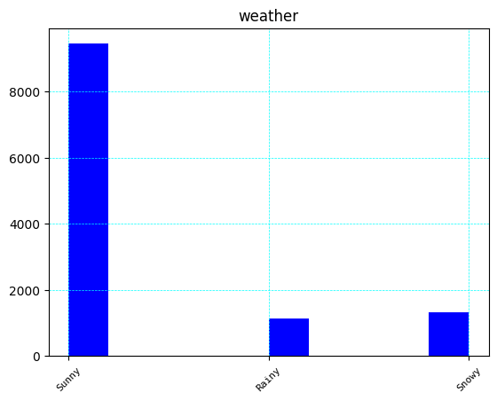
Graphical Insights
From the graph , Most drivers prefer driving during sunny weather compared to rainy or snowy weather

Slide 4
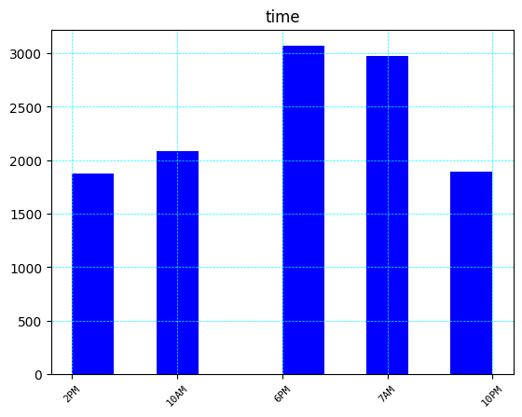
Also, drivers tend drive more at 7am and 6pm, then later at 10am, 10pm and late at 2pm respectively

Slide 5
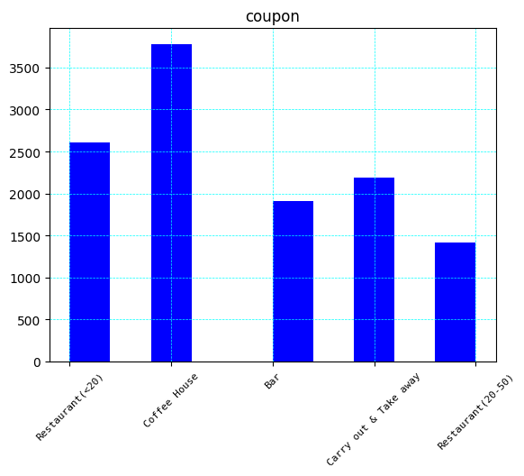
Also to note is that coffee house coupons are most demanded, followed by restaurant coupons, carryout & take away coupons in that order.

Slide 6
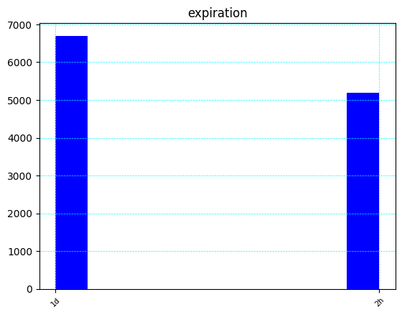
Drivers prefer coupons that have a 1 day expiry compared to just 2 hours

Slide 7
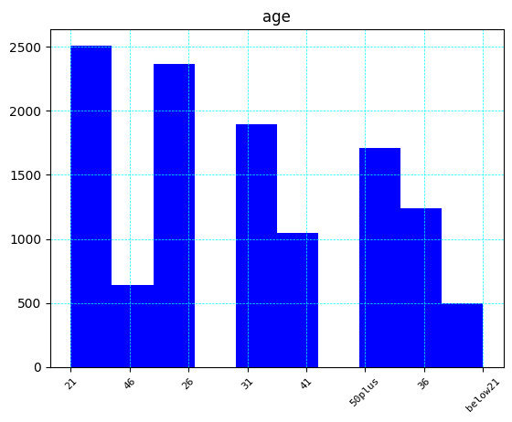
Most drivers are age 21, 26 31 and 50 plus years of age respectively

Slide 8
Strengths and limitations of the model to the stakeholder.
Random Forest Classifier is a powerful and flexible algorithm that can handle a wide range of classification tasks
Accurate: Random Forest is known for its high accuracy in predicting outcomes. This made it suitable for making predictions like on this data.
Robust to Overfitting: Random Forest is less likely to overfit than other models, as it creates multiple decision trees and averages their predictions. This helps to reduce the variance of the model and increase its accuracy.

Slide 9
Limitations of the model to the stakeholders
Overfitting: This is simply a situation where the model becomes too complex and it fails to generalize well to new, unseen data, its learned to memorize the training data instead of learning the underlying patterns and relationships that can be applied to new data. As a result, leading to poor performance of the model on new data and can limit its usefulness in real-world applications.
Feature Importance: This model may not accurately rank the importance of features if there are strong correlations between the features. In such cases, the model may give a high importance score to one feature and a low score to another feature, even if they are highly correlated. This can make it difficult to understand the true importance of each feature.

Slide 10
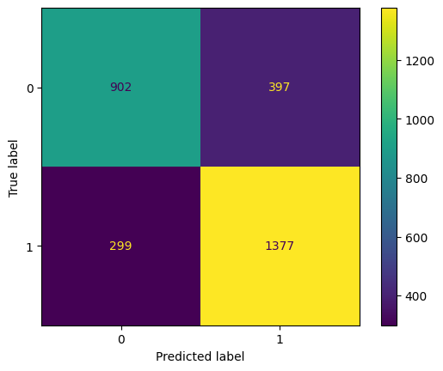
Models confusion matrix the model's false positive and false negative rates

Slide 11
Explaining how the model's false positive and false negative rates will affect your stakeholder. Be sure to consider class balance in your evaluation.
A false positive is when the model predicts that a driver will accept a coupon recommendation when in fact they will not. A false negative, on the other hand, is when the model predicts that a driver will not accept a coupon recommendation when in fact they will.
The false positive rate (FPR) and false negative rate (FNR) of the model will affect different stakeholders in different ways. For example:

Slide 12
The company offering the coupon: The model’s false positive rate is low compared to the true negatives meaning maximum sales which leads to increased profits for the company. This can be referred to the confusion matrix above
The driver: In this case the model is able to predict that drivers are able to receive coupons they are actually interested in which enables them to save.
The model developer: This model has been able to be effective and reliable, thus increasing the reputation.

Slide 13
In conclusion, based on the analysis,
Students, engineers and those that are not employed are the most drivers and therefore these are most available to participate
Based on weather, the most convenient is the sunny whether as it shows most drivers around that time, therefore companies offering these coupons should take note that drivers are likely to take on the coupons during that type of weather.
Most drivers are likely going to accept coupons at 7am and 6pm, probably when they are going to and coming back from their work places. They are also likely to take more coffee, restaurant and take away coupons more than the rest of the other coupons and therefore these should be more available and invested in.
Drivers prefer coupons with 1 day expiry time compared to the 2hr coupons and therefore these should be made more available if the targets are to be achieved
The drivers more likely to accept coupons are between the ages of 21 and 31 and therefore the marketing companies should target this age group more aggressively to realise their targets

